Slide 1

W4W Co[vi]de Breakthrough
BlockNBuy
Agile Shopping with Social distancing and being Protected !
We 4 Women :Anju, Nagaveni, Nithya & vanashree

Slide 2
Agenda
Problem Description
Impact
Solution
Benefits of application
Flow Charts
Technology Stack
Roadmap and further enhancement

Slide 3
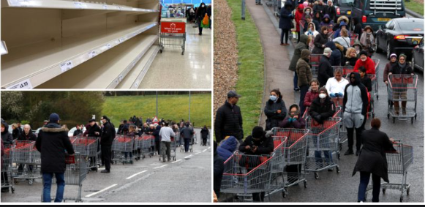
Problem Description
Due to current pandemic COVID -19 situation social distancing is one of the key factor to be maintained, especially when we connect to outside world
At times many of us come across the situation that during grocery shopping we stand in long waiting in Queue outside the shop for hours together, as the shops restrict the no. of people entry.

Slide 4
Impact on
People would be restless
Shopkeepers
Managing the crowd
Running out of shop
Increased waiting time
Risk of getting infected
Customer
Maintaining the hygiene

Slide 5
Solution
Developing an application to avoid the situation in which customers/buyers can book a slot as per their convenience. By which the time spent waiting in queue can be saved.
Even the shop keepers can manage, plan, and schedule the sanitisation.
Ensure the safe distancing.

Slide 6
Benefits of the application
Time would be saved: Booking the slots would save the time of waiting.
Maintaining social distancing and being safe: As the total number of customers is known, social distancing could be managed.
Secondary contact tracing: As the details of visitors are recorded, it would be easy to trace the secondary contact tracing and a further be intimated.
User can be intimated from shop in case of technical issues and unplanned closing of shop.
Stock availability information using chatbot.
With the early tracing, customers can stay quarantined from family and keep family safe.

Slide 7
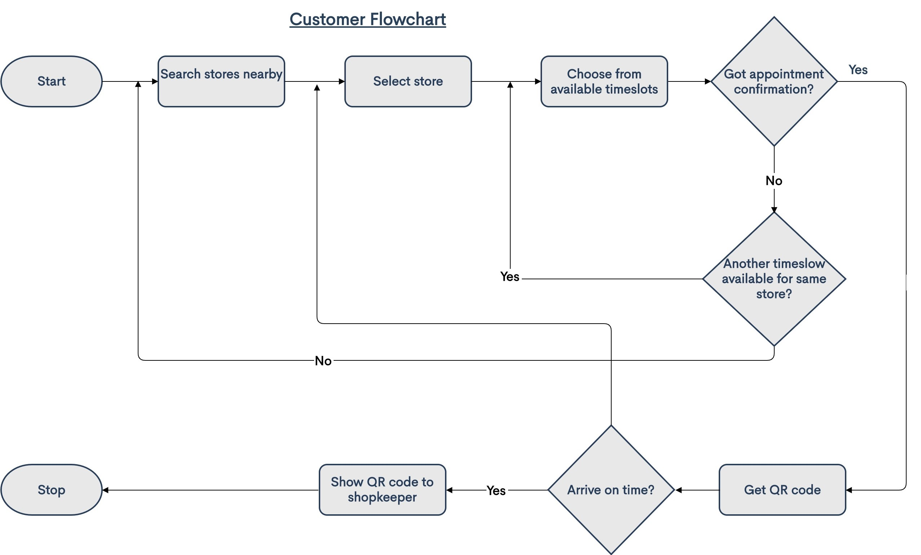
Flow Chart for the Customer

Slide 8
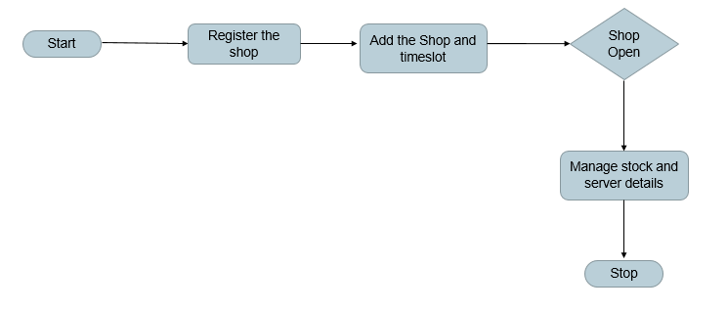
Flow Chart for the Shopkeepers

Slide 9
Technology stack
.Net Core Hybrid application
Bootstrap
QR Code
IBM Watson assitant (Chatbot)
SQL
HTML5/CSS3/Jquery

Slide 10
Roadmap and further enhancement
Chatbot/Voicebot enabled for shopping assistance
Bluetooth Support to maintain 2m distance between customers
Shopping mall with Multiple Shops
Implementing Data Analytics with collected information

Slide 11
Application Demo

Slide 12
Thank You

